Slide 1

Projections of global climate change with special reference to temperature; Rainfall
Information Security Fundamentals | Climate Change (Impacts, Adaptation and Mitigation)
Course: Information Security Fundamentals | Chapter: Climate Change (Impacts, Adaptation and Mitigation) | Program: Bachelor of Engineering
DISCOVER · LEARN · EMPOWER
Notes:
Welcome everyone to today's lecture on climate change projections. We will focus specifically on how global temperatures and rainfall patterns are expected to change. This topic is critical for understanding future environmental challenges. Remember, our goal is to empower you with the knowledge to analyze these trends.

Slide 2
Course Outcomes
SLIDE 2 / 14
Course Outcome
CO | BT LEVEL | DESCRIPTION
CO1 | BT4 | Recall, analyze and respond on fundamental environmental principles, such as ecological relationships and conservation strategies
CO2 | BT4 | Understand and analyze the interconnections between human activities and environmental impacts across different ecosystems
CO3 | BT4 | Understand and analyze and apply environmental laws and policies to analyse and propose solutions for real-world environmental challenges.
CO4 | BT2 | Students will analyse data from environmental monitoring programs to assess trends and predict future impacts on ecosystems.
CO5 | BT6 | Interpret, elaborate and propose various tools, design and innovative strategies for sustainable development and environmental conservation initiatives in securing the planet.
Chandigarh University
2 / 14
Notes:
Today's lecture directly addresses Course Outcome 3. You will learn to analyze climate data to propose solutions for real-world challenges. Understanding temperature and rainfall projections is the first step in applying environmental policies effectively. This analysis forms the basis for future mitigation strategies.

Slide 3
Learning Objectives
SLIDE 3 / 14
Learning Outcomes
1
Analyze the mechanisms driving global temperature rise projections.
2
Evaluate the relationship between warming and altered rainfall patterns.
3
Interpret climate model outputs regarding regional precipitation changes.
4
Apply quantitative methods to estimate temperature increase scenarios.
5
Critique the limitations of current climate change projection models.
Chandigarh University
3 / 14
Notes:
By the end of this session, you will be able to analyze the specific drivers of temperature rise. You will also evaluate how warming directly alters rainfall patterns globally. We will practice interpreting model outputs to understand regional differences. Finally, you will apply quantitative methods to estimate future scenarios.

Slide 4
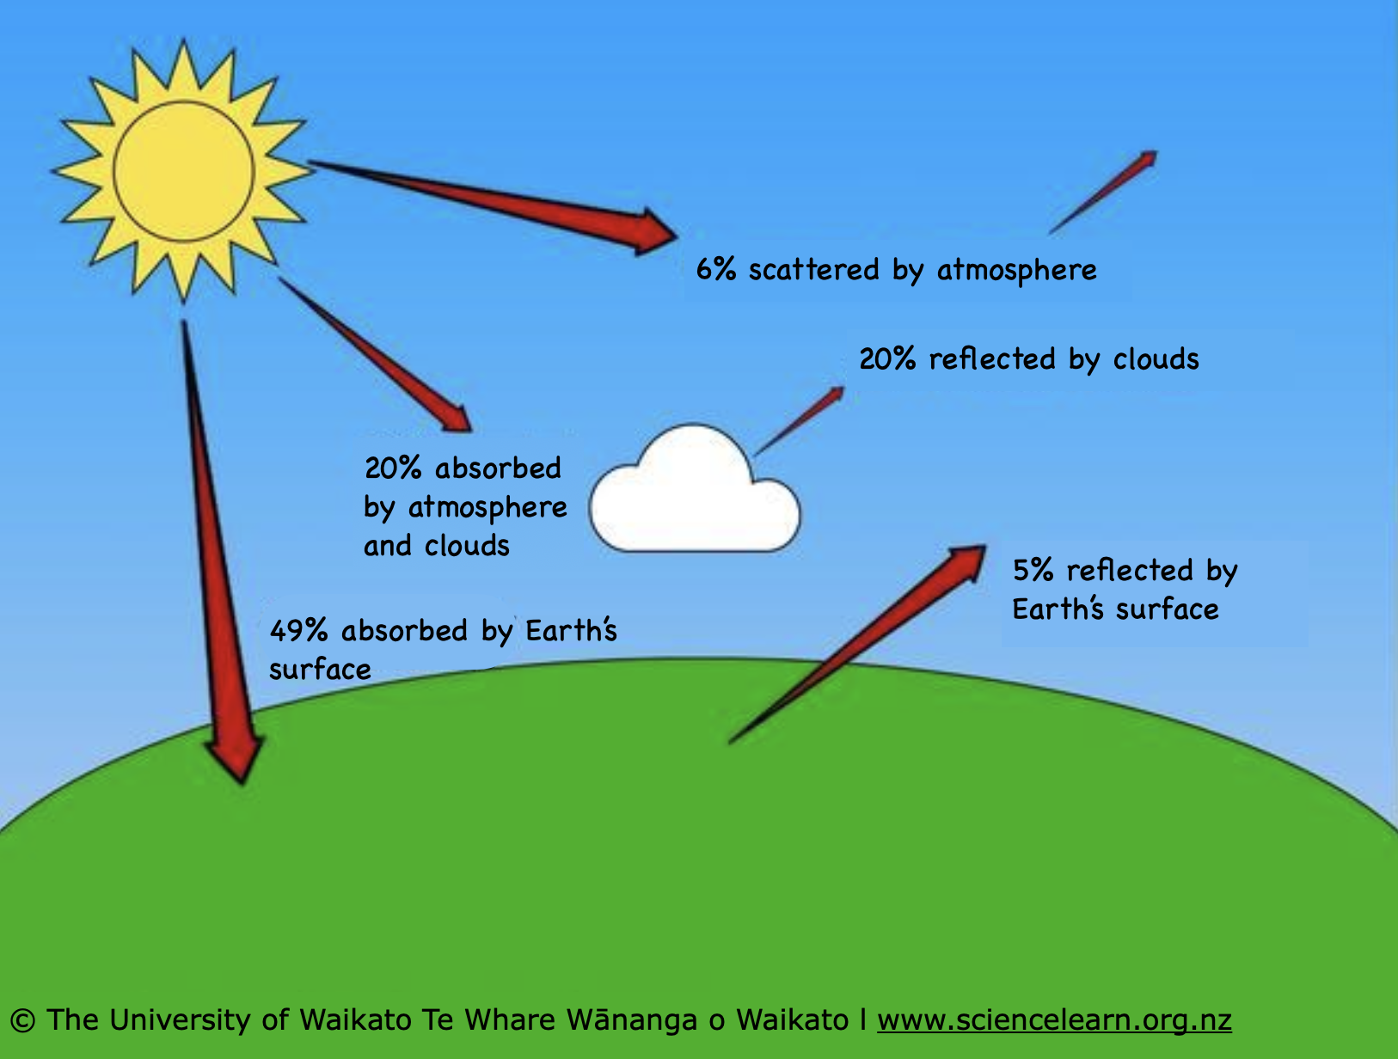
Lecture
SLIDE 4 / 14
Mechanisms of Global Temperature Rise
1
Greenhouse gases trap outgoing longwave radiation, increasing atmospheric heat.
2
CO2 concentration rise correlates directly with global mean temperature increase.
3
Feedback loops like ice-albedo effect amplify initial warming signals.
4
Ocean heat absorption delays surface temperature rise but stores energy.
5
Urban heat islands create localized temperature anomalies within projections.
Greenhouse effect — Science Learning Hub
Chandigarh University
4 / 14
Notes:
The primary mechanism is the greenhouse effect where gases trap heat. As CO2 levels rise, the atmosphere retains more energy, driving temperatures up. Feedback loops, such as melting ice reducing reflectivity, accelerate this warming. It is crucial to understand that oceans absorb much of this heat, delaying surface effects.

Slide 5
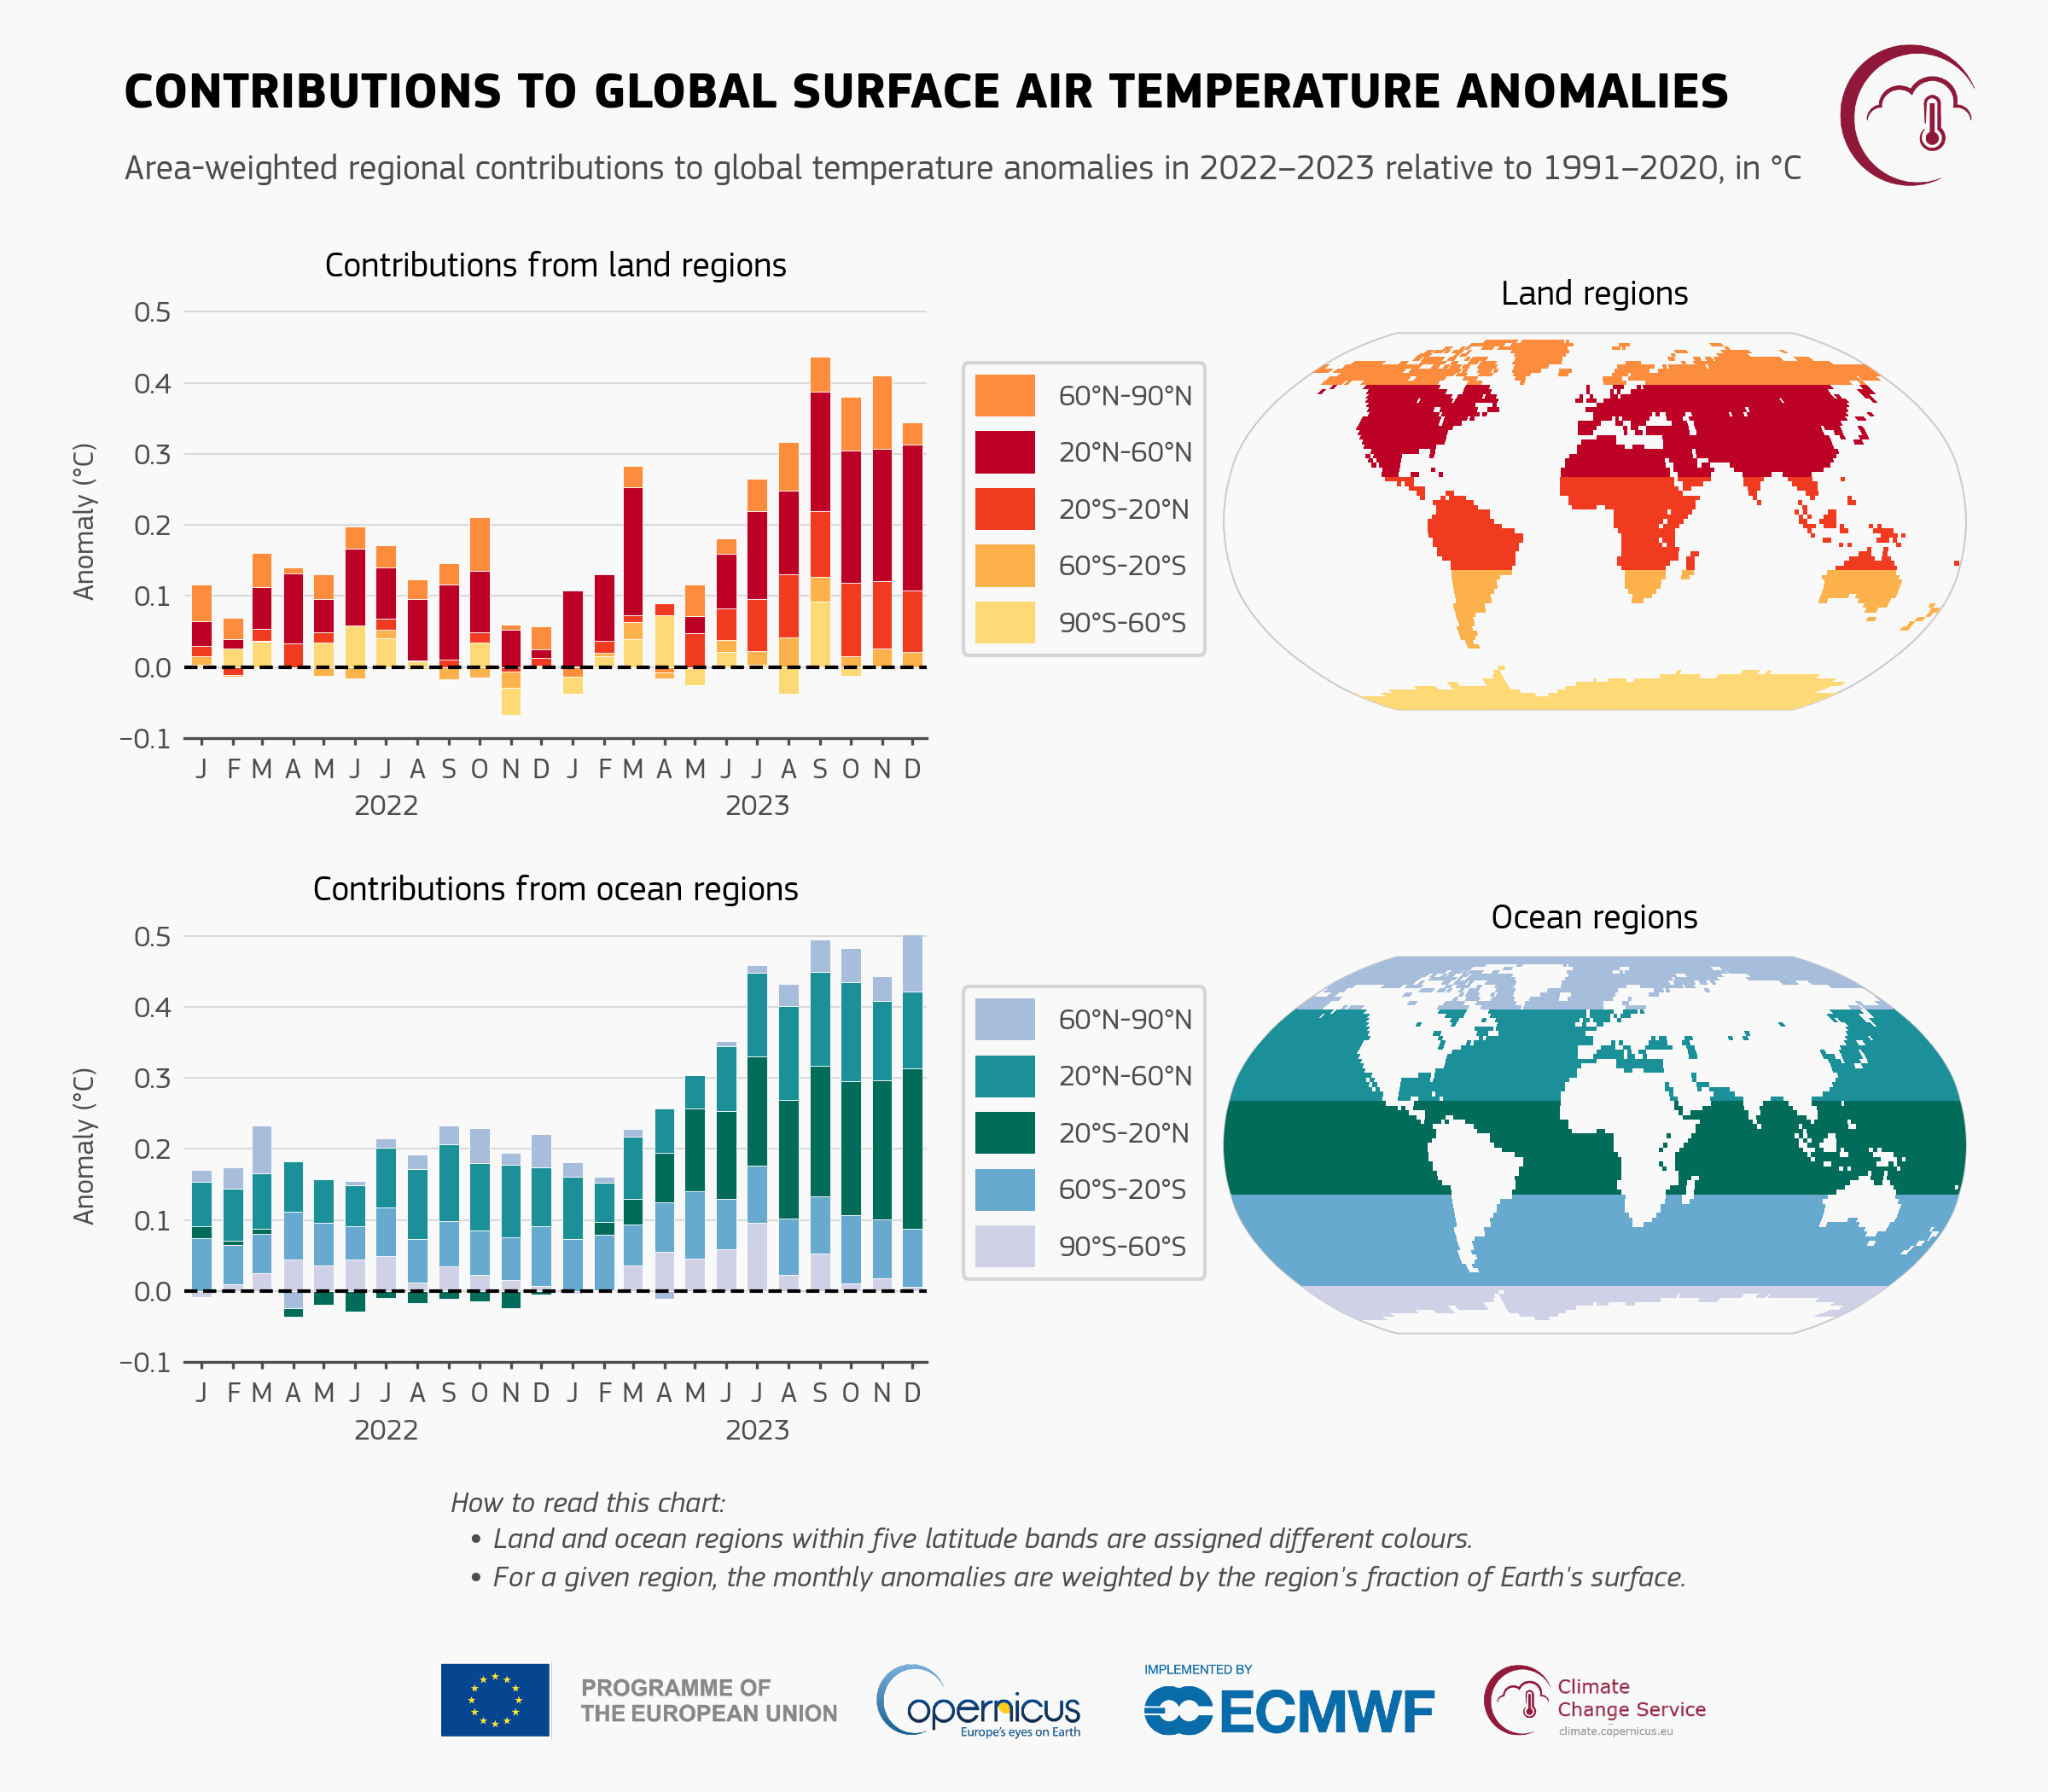
Lecture
SLIDE 5 / 14
Rainfall Patterns and Climate Shifts
1
Warmer air holds more moisture, intensifying the hydrological cycle.
2
High-latitude regions generally experience increased precipitation and flooding.
3
Subtropical zones face reduced rainfall and prolonged drought conditions.
4
Extreme rainfall events become more frequent despite total annual changes.
5
Seasonal monsoon patterns show increased variability and unpredictability.
Global Climate Highlights 2023 | Copernicus (source: climate.copernicus.eu)
Chandigarh University
5 / 14
Notes:
A warmer atmosphere holds more moisture, intensifying the water cycle. This leads to heavier rainfall in some areas and severe droughts in others. High latitudes are getting wetter, while subtropical zones are drying out. We are seeing more extreme events rather than just gradual shifts.

Slide 6
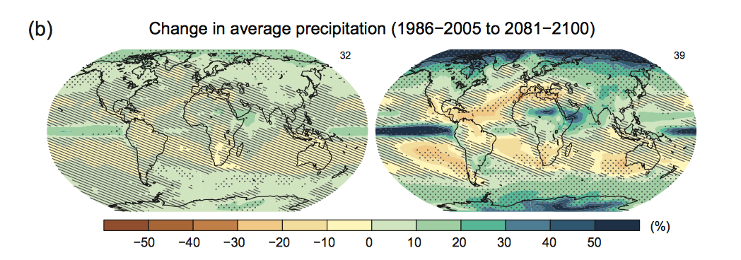
Lecture
SLIDE 6 / 14
Climate Models and Projection Methods
1
General Circulation Models simulate atmospheric and oceanic interactions.
2
Scenarios like RCP and SSP define future emission pathways.
3
Ensemble modeling reduces uncertainty by averaging multiple model outputs.
4
Downscaling techniques translate global data to regional climate details.
5
Model validation relies on historical climate data reconstruction.
Future of Climate Change | Climate Change Science | US EPA (source: 19january2017snapshot.epa.gov)
Chandigarh University
6 / 14
Notes:
We rely on General Circulation Models to simulate complex atmospheric interactions. These models use scenarios like RCP to define future emission pathways. To reduce uncertainty, scientists use ensemble modeling to average multiple results. Downscaling then helps us translate these global predictions to local regions.

Slide 7
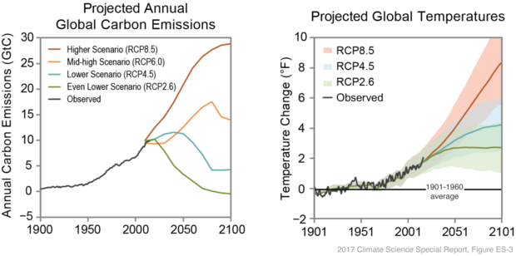
Temperature Projections
SLIDE 7 / 14
Global Averages
1
Global mean temperature is projected to rise by 1.5°C to 4.5°C by 2100.
2
Land areas warm faster than oceans due to lower heat capacity.
3
Polar regions experience amplified warming known as Arctic amplification.
4
Nighttime temperatures rise faster than daytime temperatures globally.
5
Heatwaves will become longer, more frequent, and more intense.
Climate change: global temperature | NOAA Climate.gov (source: www.climate.gov)
Chandigarh University
7 / 14
Notes:
Projections indicate a global mean rise between 1.5°C and 4.5°C by the end of the century. Land areas warm faster than oceans because they have lower heat capacity. The Arctic is warming at twice the global average rate. We also see that nighttime temperatures are rising faster than daytime ones.

Slide 8
Rainfall Projections
SLIDE 8 / 14
Regional Variability
1
Tropical regions see increased intensity but variable total annual rainfall.
2
Mediterranean climates face significant reductions in winter precipitation.
3
Monsoon regions show increased variability in onset and withdrawal dates.
4
Snowpack accumulation decreases, shifting rainfall to winter precipitation.
5
Arid zones expand, increasing the risk of desertification globally.
Global Climate Highlights 2023 | Copernicus (source: climate.copernicus.eu)
Chandigarh University
8 / 14
Notes:
Tropical regions will see more intense rainfall events, though total annual amounts vary. Mediterranean climates face significant drops in winter precipitation. Monsoon regions are becoming more unpredictable in their timing. Snowpack is decreasing, meaning more rain falls in winter instead of snow.

Slide 9
Worked Example
SLIDE 9 / 14
Estimating Temperature Rise
GOVERNING EQUATION
Formula: ΔT = λ × ΔF
λ is climate sensitivity.
CALCULATION
ΔT = 0.8 × 2.5 = 2.0°C projected temperature increase.
• Assume ΔF (radiative forcing) = 2.5 W/m² for a specific scenario.
• Assume λ (sensitivity) = 0.8 °C per W/m² for this calculation.
• This linear approximation helps estimate short-term warming trends.
Climate change: global temperature | NOAA Climate.gov (source: www.climate.gov)
Chandigarh University
9 / 14
Notes:
Let's calculate a projected temperature rise using a simplified formula. We use ΔT equals λ × δ F. If the radiative forcing is 2.5 watts per square meter and sensitivity is 0.8, the result is 2.0 degrees Celsius. This linear approximation helps us estimate short-term warming trends quickly.

Slide 10
Worked Example
SLIDE 10 / 14
Rainfall Intensity Change
GOVERNING EQUATION
Baseline rainfall intensity = 50 mm/hour for a specific storm
RULE OF THUMB
Rainfall intensity increases by 7% per 1°C warming.
CALCULATION
New intensity = 50 × (1 + 0.07 × 1.5) = 55.25 mm/hour.
• Projected warming = 1.5°C for the next 50 years.
• This 10% increase significantly raises flood risk in urban areas.
Future of Climate Change | Climate Change Science | US EPA (source: 19january2017snapshot.epa.gov)
Chandigarh University
10 / 14
Notes:
A common rule of thumb states that rainfall intensity increases by 7% per degree Celsius. If a storm currently has 50 mm/hour intensity and warming is 1.5 degrees, the new intensity is 55.25 mm/hour. This 10% increase significantly raises flood risk in urban areas. It is a critical factor for infrastructure planning.

Slide 11
Lecture
SLIDE 11 / 14
Common Pitfalls in Climate Projections
1
Confusing weather variability with long-term climate trends incorrectly.
2
Overlooking regional differences when applying global average data.
3
Ignoring model uncertainty ranges in favor of single point estimates.
4
Assuming linear relationships where feedback loops cause non-linear jumps.
5
Neglecting the impact of land-use changes on local microclimates.
Global Climate Highlights 2023 | Copernicus (source: climate.copernicus.eu)
Chandigarh University
11 / 14
Notes:
A common pitfall is confusing weather variability with long-term climate trends. Students often overlook regional differences when applying global averages. Ignoring model uncertainty ranges in favor of single point estimates is also risky. We must assume non-linear jumps due to feedback loops rather than simple linear relationships.

Slide 12
Lecture
SLIDE 12 / 14
Impacts on Water Resources and Agriculture
1
Glacial melt reduces long-term freshwater availability for downstream regions.
2
Altered rainfall timing disrupts planting seasons and crop yields.
3
Increased evaporation rates reduce soil moisture during critical growth periods.
4
Salinization of coastal aquifers threatens freshwater supplies in deltas.
5
Drought frequency increases irrigation demands and water scarcity risks.
Chandigarh University
12 / 14
Notes:
Glacial melt reduces long-term freshwater availability for downstream regions. Altered rainfall timing disrupts planting seasons and reduces crop yields. Increased evaporation rates reduce soil moisture during critical growth periods. Salinization of coastal aquifers also threatens freshwater supplies in deltas.

Slide 13

Lecture
SLIDE 13 / 14
Key Takeaways
1
Global temperatures are projected to rise significantly by 2100.
2
Rainfall patterns are shifting towards more extreme and variable events.
3
Regional impacts vary, with some areas facing droughts and others floods.
4
Quantitative models help estimate specific temperature and rainfall changes.
5
Understanding these projections is essential for environmental policy solutions.
Source: www.slideteam.net
Chandigarh University
13 / 14
Notes:
To summarize, global temperatures are projected to rise significantly by 2100. Rainfall patterns are shifting towards more extreme and variable events. Regional impacts vary, with some areas facing droughts and others floods. Quantitative models help estimate specific temperature and rainfall changes. Understanding these projections is essential for environmental policy solutions.

Slide 14
Lecture
SLIDE 14 / 14
References
ENVIRONMENTAL STUDIES
From Crisis to Cure — R. Rajagopalan
• Environmental Science and Engineering — Benny Joseph
• Environmental Studies — R.C. Sharma and D. Gurbir Sangha
• Introduction to Environmental Science — Anjaneyulu, Y.
• Environmental Pollution Control Engineering — C.S. Rao
• Textbook of Environmental Studies for undergraduate courses — E. Bharucha
• Environmental Science — S.C. Santra
Chandigarh University
14 / 14
Notes:
These are the primary reference books for this lecture. Please consult Benny Joseph and R.C. Sharma for detailed environmental studies. Anjaneyulu and C.S. Rao provide excellent insights into pollution control. E. Bharucha and R. Rajagopalan offer comprehensive undergraduate perspectives. Finally, S.C. Santra's work is a key resource for this course.

